Slide 1

Presented By:
Sheetal naik

Slide 2
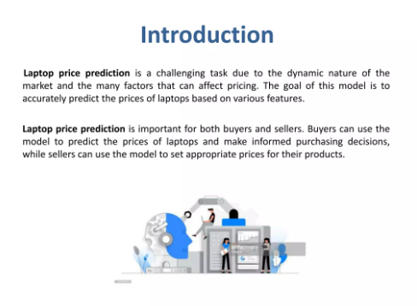

Slide 3


Slide 4
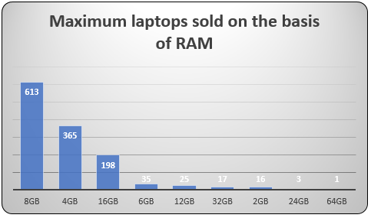
Key InSights
Maximum laptop sold basis on RAM :The maximum random access memory (RAM) installed in any computer system is limited by hardware, software and economic factors.
The hardware may have a limited number of address bus bits, limited by the processor package or design of the system. From the plot we can understand that as RAM
increases the price of Laptop increases . Depends on the usage of the memory , the user decides the laptop and accordingly prefers the brand of laptop.

Slide 5
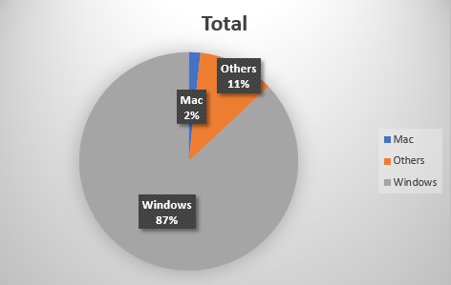
Based On OS:: There are many categories of Operating Systems. We will keep all windows categories in one, MAC in One, and remaining in others. This is the simple way
and most used feature engineering method. When we plot price against operating system then as usual MAC is most expensive.

Slide 6
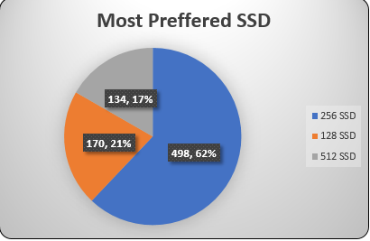
Based on SSD: SSDs store data permanently inside an integrated circuit, typically using flash memory. The flash memory inside an SSD means data is written,
transferred, and erased electronically and silently — SSDs don't have the moving parts found inside mechanical hard-disk drives (HDDs).From the chart we can conclude
the users prefer highest SSD to store the data .

Slide 7
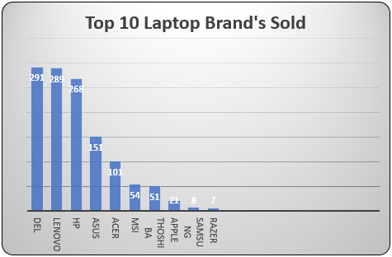
Top 10 Laptop sold based on Brand :We want to understand how brand name impacts the laptop price or what is the average price of each laptop brand?
If we consider bar chart of a company then the major categories present are Dell, Lenovo , HP, Asus ,etc.
Now after plotting the company relationship with price then we can observe that how price varies with different brands.
Razer , Samsung, Apple are expensive and others are in budget range.

Slide 8
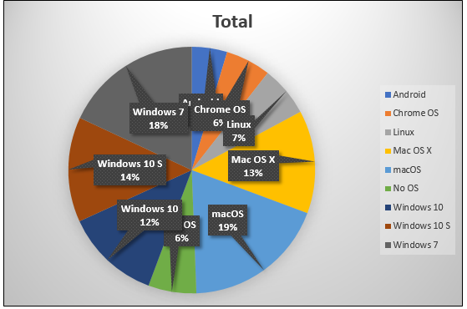
Average price of the Laptop: From the chart we can conclude that MAC is expensive compared to all other Brands of Laptop, remaining Laptop brands are in the budget
range for the users. MAC is expensive because of there OS , high security and other features.

Slide 9
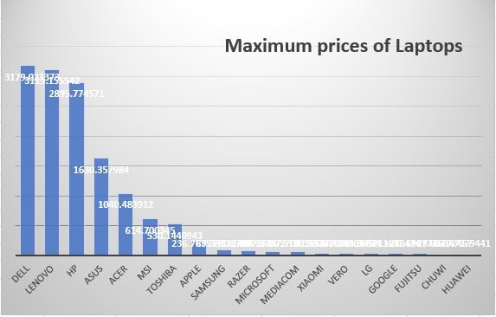
Laptop company Popular: From the plot we can say that most sold Laptop Brand is Dell , Lenovo ,HP , etc. It completely depends on the Budget range , usage of memory
and comfortability of the users.

Slide 10
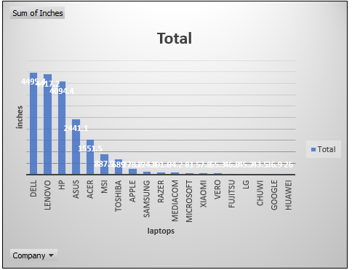
Top 10 laptop with Inches: We get a general question that Does price varies with laptop size in inches ??
Yes , the price varies with laptop size in inches ,to understand it in better way we have showed in figure. From the chart we can conclude that there is a relationship
but not so strong relationship between the price and the size column.

Slide 11
Data Analysis: Various statistical methods were applied to derive valuable insights from the data.
Data Visualization: Excel was utilized as a visualization tool to create attractive charts, graphs, and interactive visuals for presenting the data in an easily understandable manner.
Dashboard Creation: Finally, a dashboard was built in Excel by incorporating slicers and timelines, enabling users to interact with the data and explore different perspectives.
1. Requirement gathering from client
2. Identify the Stakeholders of the Project
3. Data cleaning as per the requirement
4. Data Processing by adding some customized columns in data
5. Data Analysis by Pivot Tables and Excel Functions
6. Data Visualization to create charts and custom sheets to show the insights
7. Report/ Dashboard creation from start to end

Slide 12
Conclusion
Predicting something through the facts is not so easy especially in determining the choice of laptop specifications that are most desirable for Professional to meet
there needs and in accordance with the purchasing power of normal people. People no longer need to look for various sources to find laptop specifications that are
needed by them in meeting the needs , because the laptop specifications from the results of the Power tool like Excel we have provided the most desirable specifications with their prices of laptops.

Slide 13


